Slide 1


Course Title : Computer network. Course Code : ICT-3207
Presenter by:
Abdullah al mamun & Iqbal Hossen .
IT-18040 & It-18041.
DEPERTMENT OF ICT .
3rd YEAR 2ND SEMRSTER .
Mawlana Bhashani Science and Technology University ,Santosh-1902, Tangail .

Slide 2
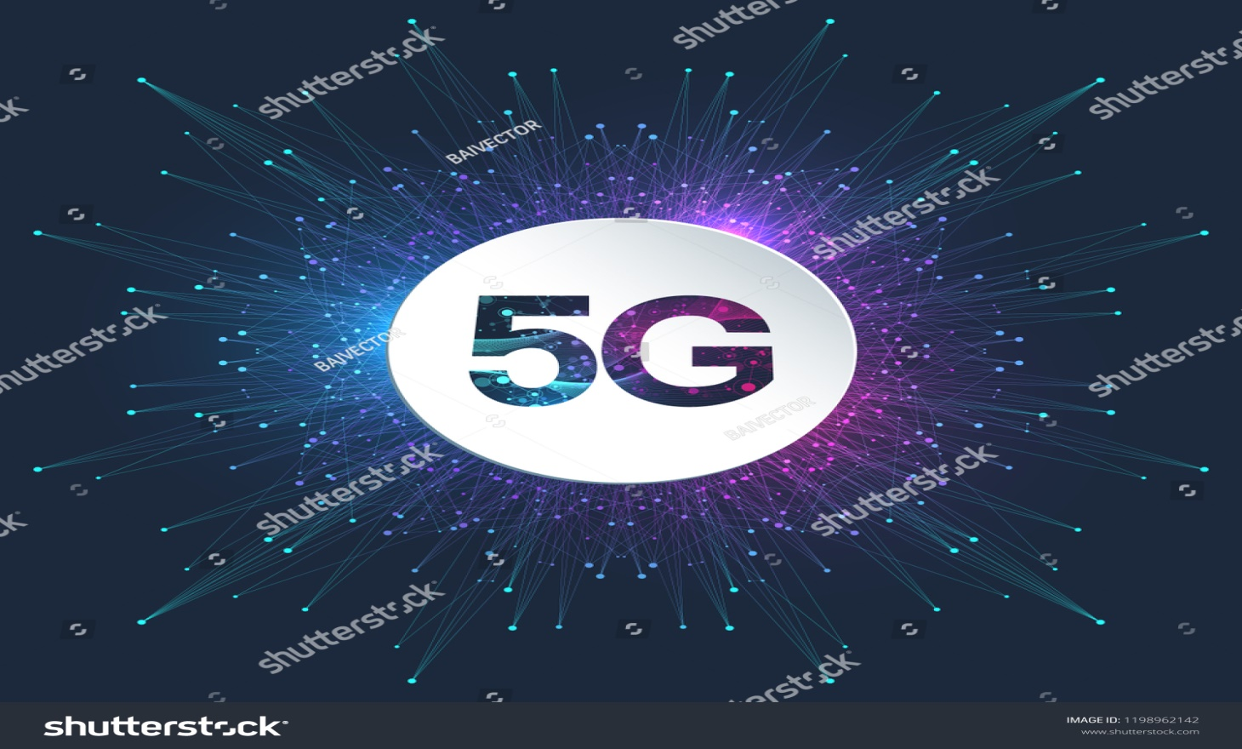
Presentation topic:

Slide 3
Contents:
1. What is network and what is 5G network?
2. Overview of 1G,2G,3G and 4G network.
3. Feature of the 5G network.
4. Application of the 5G network and when 5G launch?
5. Compare 5G network between other network like 1G,2G,3G,4G.
6. What will 5G enable?
7. How does 5G Work?And 5G Spectrum
8. Important Advantages and disadvantage
9. 5G - Future Scope

Slide 4

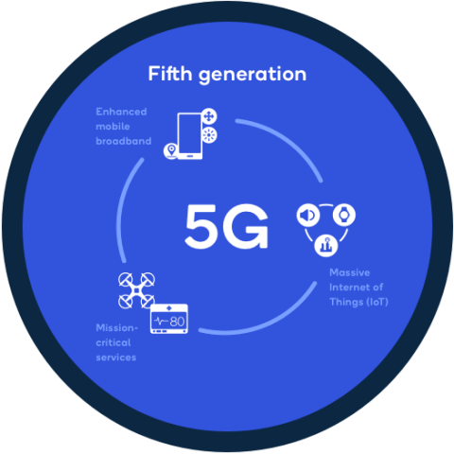
What is Network??
A computer network is defined as the
interconnecting of two or more computers.
It is done to enable the computer to
Communication and share available resources.
What is 5G network??
5G is the fifth generation of cellular data technology.
It succeeds 4G and related technologies , including LTE.
The first 5G cellular network were constructed in 2018,
while 5G devices became widespread in 2019 and 2020.

Slide 5
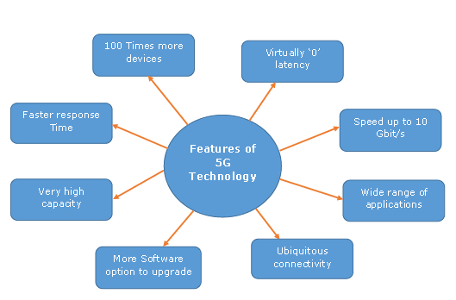
Basic Feature of 5G network.

Slide 6
**Application of 5G network .
It will make unified global standard foe all.
Network availability will be everywhere and will facilitate people to use their computer and such kind of mobile devices anywhere anytime.
Its application will make world real wi-fi zone.
Its application will facilitate people to avail radio signal at higher altitude as well.
**When 5G lunch??
Initial 5G services commercially launch many countries in 2019 and widespread availability of 5G is expected by 2025.

Slide 7
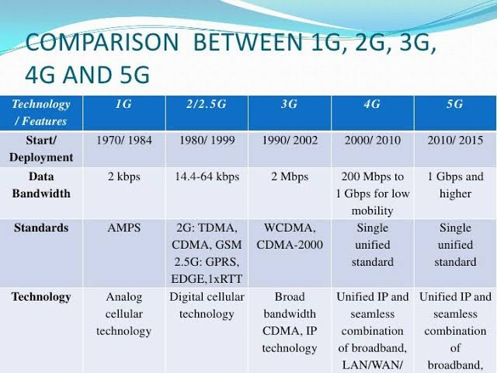
Compare 5G network and other network like 1G,2G,3G,4G.

Slide 8
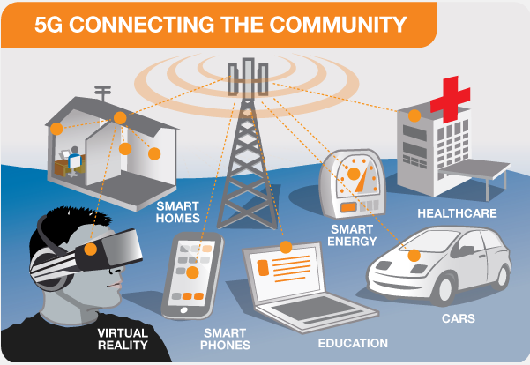
What will 5G enable
5G will enable instantaneous connectivity to billions of devices, the Internet of Things (IoT) and a truly connected

Slide 9

5G will provide the speed, low latency and connectivity to enable a new generation of applications, services and business opportunities that have not been seen before.
There are three major categories of use case for 5G
Massive machine to machine communications
Ultra-reliable low latency communications
Enhanced mobile broadband –

Slide 10
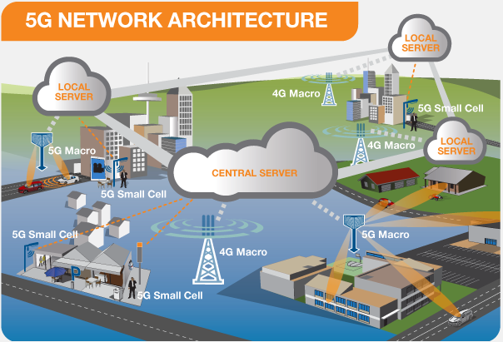
How does 5G Work .

Slide 11

1) 5G architectures will be software-defined platforms, in which networking functionality is managed through software rather than hardware. Advancements in virtualization, cloud-based technologies, and IT and business process automation enable 5G architecture to be agile and flexible and to provide anytime, anywhere user access
2) 5G technology will introduce advances throughout network architecture. 5G New Radio, the global standard for a more capable 5G wireless air interface, will cover spectrums not used in 4G. New antennas will incorporate technology known as massive MIMO (multiple input, multiple output), which enables multiple transmitters and receivers to transfer more data at the same time

Slide 12
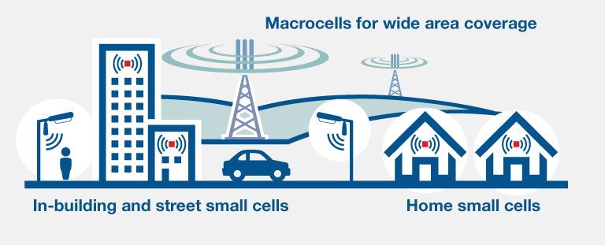
BETTER CONNECTION - ALWAYS CONNECTED
5G networks are designed to work in conjunction with 4G networks using a range of macro cells, small cells and dedicated in-building systems. Small cells are mini base stations designed for very localised coverage typically from 10 metres to a few hundred metres providing in-fill for a larger macro network. Small cells are essential for the 5G networks as the mmWave frequencies have a very short connection range.

Slide 13
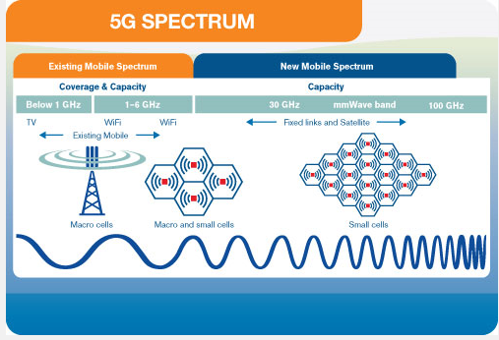
5G Spectrum The 5G spectrum is a range of radio frequencies in the sub-6 GHz range and the millimeter-wave (mmWave) frequency range that is 24.25 GHz and above.
The 5G spectrum refers to the radio frequencies that carry data from user equipment (UE) to cellular base stations to the data’s endpoint. LTE networks use frequencies in the sub-6 GHz range and will be sharing the space with 5G traffic. The lower frequency bands will be used for less-densely populated areas because data can travel further, though slower, on these frequencies.
In order to utilize the newly-available mmWave spectrum, 5G networks will have to use the 5G New Radio technology being standardized by the 3GPP.

Slide 14
Important Advantages
High resolution and bi-directional large bandwidth shaping.
Technology to gather all networks on one platform.
More effective and efficient.
Technology to facilitate subscriber supervision tools for the quick action.
Most likely, will provide a huge broadcasting data (in Gigabit), which will support more than 60,000 connections.
Easily manageable with the previous generations.
Technological sound to support heterogeneous services (including private network).
Possible to provide uniform, uninterrupted, and consistent connectivity across the world.

Slide 15

Disadvantages of 5G Technology
Technology is still under process and research on its viability is going on.
The speed, this technology is claiming seems difficult to achieve (in future, it might be) because of the incompetent technological support in most parts of the world
Developing infrastructure needs high cost.
Security and privacy issue yet to be solved.

Slide 16
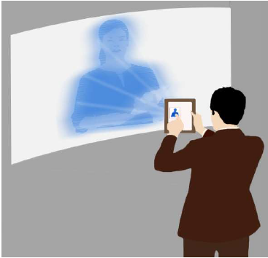
5G - Future Scope
5th generation technology is designed to provide incredible and remarkable data capabilities, unhindered call volumes, and immeasurable data broadcast within the latest mobile operating system. Hence, it is more intelligent technology, which will interconnect the entire world without limits. Likewise, our world would have universal and uninterrupted access to information, communication, and entertainment that will open a new dimension to our lives and will change our life style meaningfully.
Moreover, governments and regulators can use this technology as an opportunity for the good governance and can create healthier environments, which will definitely encourage continuing investment in 5G, the next generation technology.

Slide 17

Have you any question?

